Slide 1
3- Strings

Slide 2
Single/double quotes
As I told you before, whenever you work with texts you should surround your text with quotes. You can either use double quotes or single quotes. That's more of a personal preference.

Slide 3
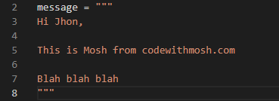
We also have triple quotes and we use them to format a long string.
That is the message we want to include in thebody of an email. You can use triple quotes toformat it like this. Hi

Slide 4

What is the function?
A function is basically a reusable piece of code that carries out a task.
we have functions that are built into the languageand the platform.
You can reuse these functions to perform various tasks.

Slide 5
a few useful things you can do with strings.
built in function in python
Len function:
to get the length of a string (the number of characters in that string.)
whenever you wanna use a function, you should use parenthesis. Now we say we’re calling this function; which basically means we're using this function now.

Slide 6

arguments
some functions take additional data, which we refer to as arguments.
These arguments are input to these functions.
so this len function takes an input or an argument.
Here we pass our course variable.
and this will return the number of characters in this string.

Slide 7
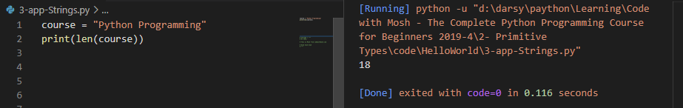

Slide 8

If you want to get access to a specific character in the string. you use the square bracket notation
So in python, like many other languages, strings are zero index which means the index ofthe first character or the first element is zero

Slide 9
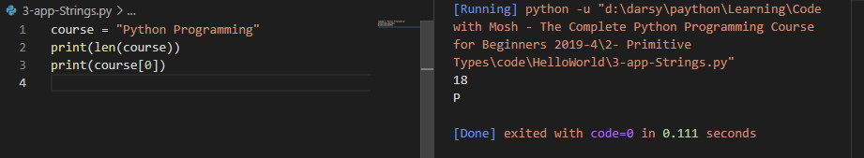
course[0]

Slide 10
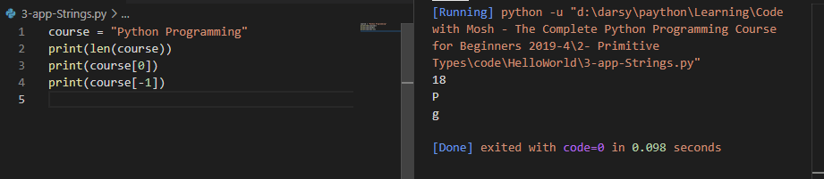
course[-1]
Negetive index
That takes us back to the end of the string. So that returns the first character from the end of the string.

Slide 11
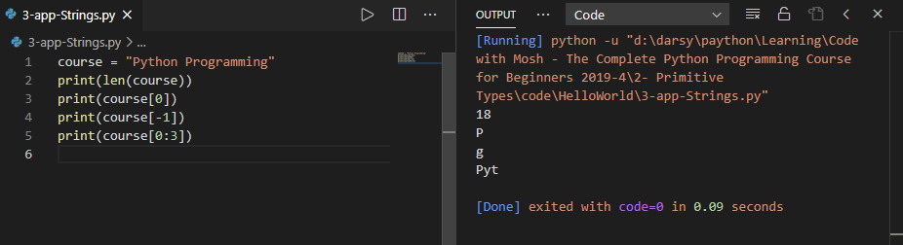
course[0:3]
Using a similar syntax, you can slice strings.
we need two indexes: the start Index colon, the end index.
the character at the end index is not included

Slide 12
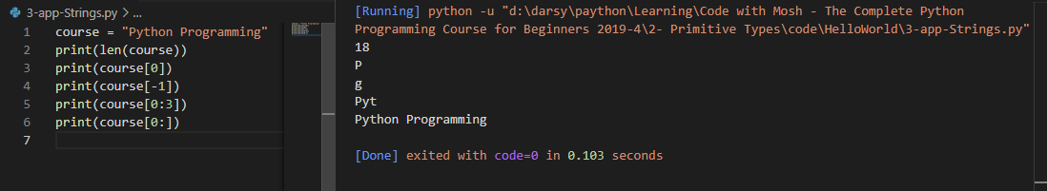
course[0:]

Slide 13
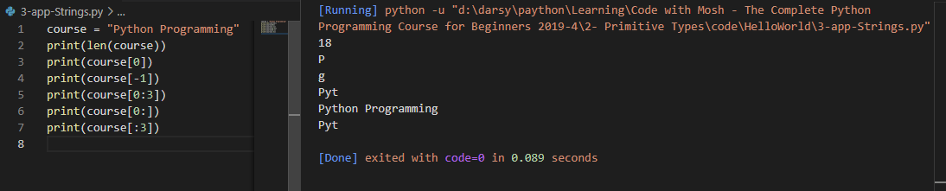
course[:3]

Slide 14
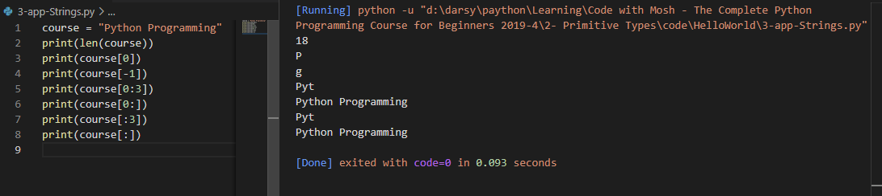
course[:]

Slide 15
you don't have to memorize any of these.
Just remember
Len(variableName)
we use the len function to get the length of a string.
[]
We use bracket notation [] to get access to a specific element/character.
[:]
and we use this notation [:] to slice a string

